Slide 1
Formal Languages and Grammars

Slide 2
Grammars
A formal grammar G is any compact, precise mathematical definition of a language L.
As opposed to just a raw listing of all of the language’s legal sentences, or just examples of them.
A grammar implies an algorithm that would generate all legal sentences of the language.
Often, it takes the form of a set of recursive definitions.
A popular way to specify a grammar recursively is to specify it as a phrase-structure grammar.

Slide 3
Grammars (Semi-formal)
Example: A grammar that generates a subset of the English language

Slide 5
A derivation of “the boy sleeps”:

Slide 6
A derivation of “a dog runs”:

Slide 7
L = { “a boy runs”,
“a boy sleeps”,
“the boy runs”,
“the boy sleeps”,
“a dog runs”,
“a dog sleeps”,
“the dog runs”,
“the dog sleeps” }

Slide 8
Notation
Variable
or
Non-terminal
Symbols of
the vocabulary
Terminal
Symbols of
the vocabulary
Production
rule

Slide 9
Syntax
Context-Free Grammars, Syntax Trees

Slide 10
CFG for Arithmetic Expressions
E ::= E op E | (E) | num
op ::= + | *
num ::= 0 | 1 | 2 | …
Backus-Naur Form (BNF)
Nonterminals {E, op, num}
Terminals { ( , ) , + , * , 0 , 1 , 2 , …}

Slide 11
CFG for Arithmetic Expressions
E ::= E op E | (E) | num
op ::= + | *
num ::= 0 | 1 | 2 | …
E ::= E + E | E * E | (E) | 0 | 1 | 2 | …
Equivalent grammars generate same language

Slide 12
Derivations
E ::= E op E | (E) | num
op ::= + | *
num ::= 0 | 1 | 2 | …
E
E op E
num op E
1 op E
1 * E
1 * E op E
1 * num op E
1 * 2 op E
1 * 2 + E
1 * 2 + num
1 * 2 + 3
1 * 2 + 3

Slide 13
Derivations
E ::= E + E | E * E | (E) | 0 | 1 | 2 | …
E
E + E
E * E + E
1 * E + E
1 * 2 + E
1 * 2 + 3
1 * 2 + 3

Slide 14
Leftmost – Rightmost Derivation
E ::= E + E | E * E | (E) | 0 | 1 | 2 | …
E
E + E
E * E + E
1 * E + E
1 * 2 + E
1 * 2 + 3
E
E * E
E * E + E
E * E + 3
E * 2 + 3
1 * 2 + 3

Slide 15
Parse Trees
E ::= E + E | E * E | (E) | 0 | 1 | 2 | …
1 * 2 + 3 E
E + E
E * E 3
1 2

Slide 16
Parse Trees
E ::= E + E | E * E | (E) | 0 | 1 | 2 | …
1 * 2 + 3 +
* 3
1 2

Slide 17
Ambiguity
E ::= E + E | E * E | (E) | 0 | 1 | 2 | …
* +
1 + * 3
2 3 1 2
Two different parse trees for 1 * 2 + 3 !!
Let’s rewrite the grammar…

Slide 18
Unambiguous Arithmetic Grammar
E ::= E + T | T
T ::= T * F | F
F ::= num | (E)
* has precedence over +; “binds tighter”
Left-recursive, Left-associative

Slide 19
Unambiguous Arithmetic Grammar
E ::= E + T | T
T ::= T * F | F
F ::= num | (E)
E
E + T
E + T * F
E + T * (E)
E + T * (E + T)
E + T * (E + F)
E + T * (E + 5)
E + T * (T + 5)
E + T * (F + 5)
E + T * (7 + 5)
E + F * (7 + 5)
E + 3 * (7 + 5)
T + 3 * (7 + 5)
F + 3 * (7 + 5)
2 + 3 * (7 + 5)

Slide 20
Left- vs. Right- Recursive
E ::= E + T | T
T ::= T * F | F
F ::= num | (E)
3 * 4 * 5
*
* 5
3 4
Left-Associative
E ::= T + E | T
T ::= F * T | F
F ::= num | (E)
3 * 4 * 5
*
3 *
4 5
Right-Associative

Slide 21
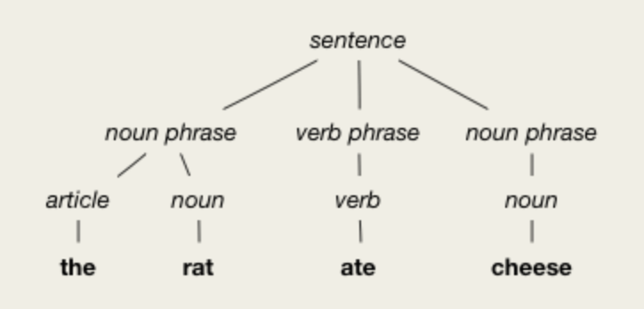
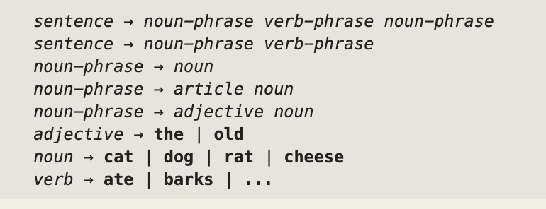
English Language Grammar and Parse Tree

Slide 22
English Language Grammar and Parse Tree

Slide 23
English Language Grammar and Parse Tree

Slide 24
A more program-like grammar
S ::= S; S | id = E
| while E do {S} | if E then {S}
| if E then {S} else {S}
E ::= E + T | E == T | not E | T
T ::= id | num
S – “statements”
E – “expressions”
T – “terms”

Slide 25
A more program-like grammar
S ::= S; S | id = E
| while E do {S} | if E then {S}
| if E then {S} else {S}
E ::= E + T | E == T | not E | T
T ::= id | num
i = 1;
sum = 0;
while not i == 10
do { i = i + 1;
sum = sum + i } Ambiguity?

Slide 26
A more program-like grammar
S ::= S ; S | id = E
| while E do {S} | if E then {S}
| if E then {S} else {S}
E ::= E + T | E == T | not E | T
T ::= id | num
i = 1; i = 1;
sum = 0; sum = 0;
while not i == 10 while not i == 10
do { i = i + 1; do { i = i + 1;
sum = sum + i } sum = sum + i }

Slide 27
A more program-like grammar
C – “compound statement”
C ::= S | S;C (right recursive)
S ::= S;S | id = E
| while E do {C} | if E then {C}
| if E then {C} else {C}
E ::= E + T | E == T | not E | T
T ::= id | num

Slide 28
More Ambiguity: “Dangling Else”
if E1 then if E2 then S1 else S2
if (y > z)
if (z > x)
max = y;
else max = ?; // which if?

Slide 29
Parse Tree
i = 1;
sum = 0;
while not i == 10
do { i = i + 1;
sum = sum + i}
;
= ;
i 1
= while
sum 0 not ;
== = =
i 10 i + sum +
i 1 sum i

Slide 30
Parsing
Produce the abstract syntax tree for a given program (token stream)
Uses of Parse Trees:
Translate from one language to other
From JAVA to machine code
From English to French
Characteristic signature of an author

